Slide 1
MTSS & SEL
in EBR
Presented to:Special Education Advisory Council
October 13, 2022
Dr. Corie Buras, Director MTSS

Slide 2
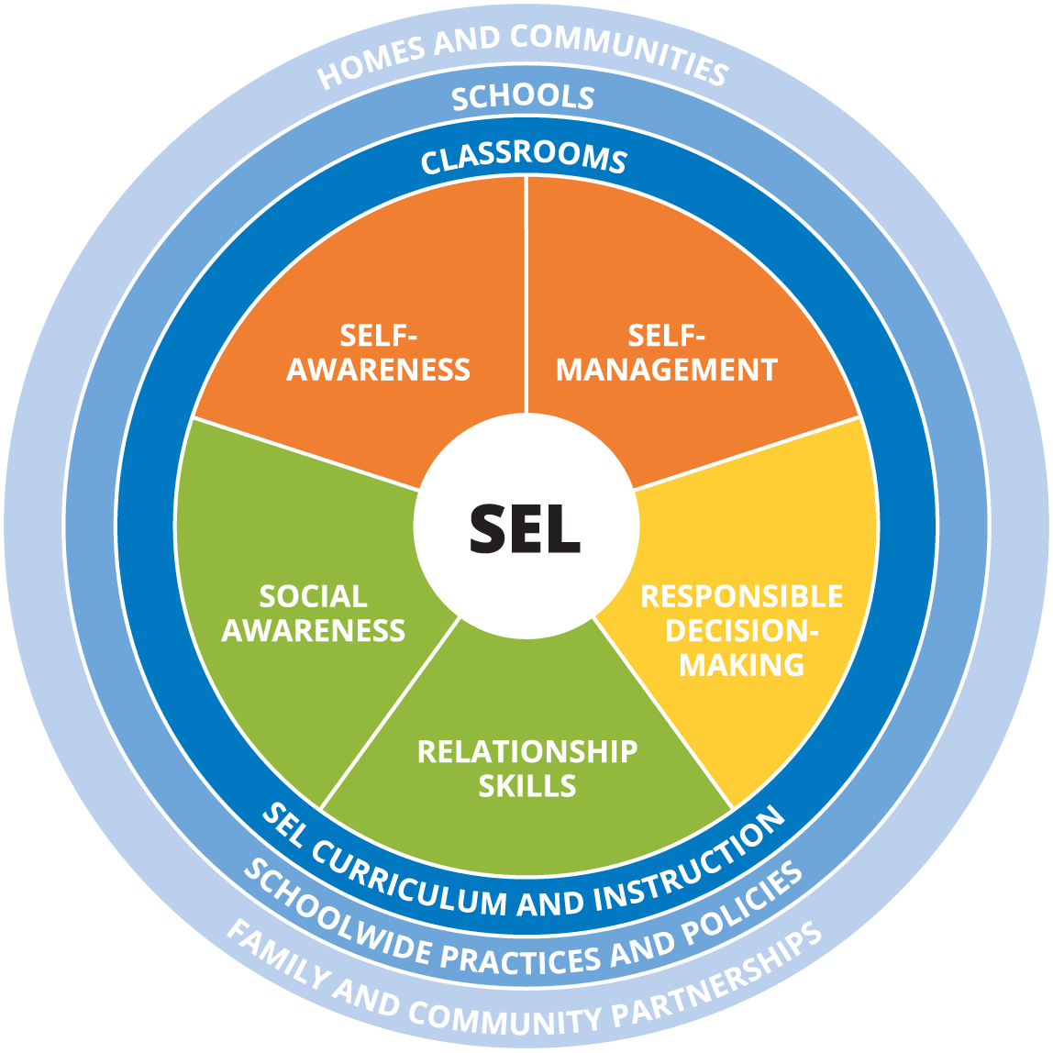
What is MTSS & SEL
A systematic approach to organize and implement multiple support programs on a school campus.
A process to continually examine and refine intervention practices.
A framework to build a structure to address the needs of “The Whole Child” by recognizing that supporting the emotional and behavioral needs of a child will increase their ability to learn.
Recognizes the need to not implement academic, behavioral and social supports in isolation from one another.
Research based

Slide 3
3 Year Timeline
Year 1:
Implement universal SEL curriculum in ALL schools. Develop district MTSS plan and framework. Provide Step-by-step support for schools to build MTSS plans based off district framework.
Year 2:
Have schools implement their MTSS plan: Focus on the school support team and identifying needs. Norm and refine practices. Continue to implement universal curriculum and give additional support with new elements.
Year 3 and beyond:
Have fully integrated MTSS implemented on every campus that address the academic, behavioral and emotional needs of students. Continue to implement curriculum and provide support as needed.

Slide 5
Operational Definitions
MTSS: Multi-Tiered Systems of Support is a systematic, integrated, and multilayered approach used to deliver instruction, assess student progress, and provide needed supports and intervention. It is evidenced and research based.
Social Emotional Learning (SEL) is the process of developing the self-awareness, self-control, and interpersonal skills that are vital for school, work, and life success.
Academics: refers to instructional practices, goals, and interventions that are directly related to a students understanding of the content. This can be measured by grades, reading levels, and test performance data.
Behavior: refers to instruction, goals, and objectives that directly influence a student’s behavior and decision making skills.
Key Performance Indicators: Focus areas the school district has identified to measure the success of student academic and behavioral improvement.
Data-based Decision Making: Examining multiple data points to make individualized and informed decisions that drive instruction and interventions.
 | Social Emotional Learning | Academics | Behavior
Tier I: Universal screening & High- quality teaching and learning for ALL students. | Universal SEL lessons across all schools. SEL screener for students 3rd-12th grade. | Universal curriculum and across all schools and content areas. Universal screeners and assessments to measure progress. | School-wide behavioral interventions and supports.
Tier II: Targeted support through supplemental interventions | Individual and/or small group support with counselor or other trained district personnel. | Research-based instructional and online programs as well as targeted small group instruction. | Restorative and trauma informed practices as well as targeted individual or/or group counseling.
Tier III: Intensive intervention and additional individualized supports | Individual and/or small group support with counselor or other trained district personnel. | Individualized instructional supports based on student needs and data. | Individualized behavior support plans based on student needs

Slide 6
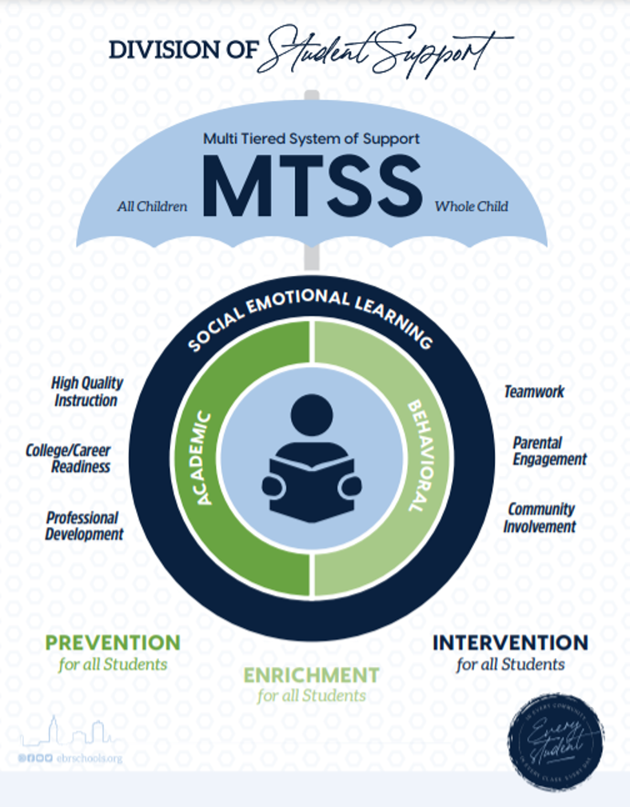
Built on a foundation of Social Emotional Learning because we understand we must address the needs of the whole child in order for our students to thrive.
Has a strong emphasis on Prevention
Through a strong Tier I
Through early intervention based on data
Through the use of researched based practices
Addresses the academic, behavioral, and social emotional needs of students by looking for causation and relationships
Root Cause analysis through examining all data points
Not addressing needs in isolation

Slide 7
SEL Partners: CASEL & RethinkED
Collaborative for Academic, and Social Emotional Learning
(CASEL) www.casel.org
Universal Curriculum & Screener
Completing District Implementation Plan:
Goals, Instruction, Student Progress, Stakeholder Communication, Initial and ongoing training schedule, Implementation reviews
Professional Development:
Initial Training & Functionality: Introduction and how to use the platform
School and District Leadership, teachers, school counselors, school and district support staff.
https://www.rethinked.com/edu/

Slide 8
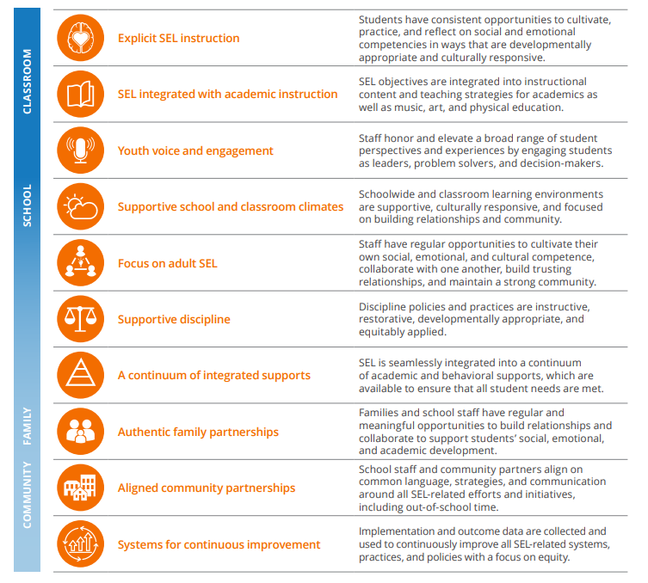
Addressing SEL through the MTSS Plan
Following CASEL recommendations each school will focus on two of the elements of schoolwide SEL.
Additionally schools identified how they will schedule time dedicated to explicit SEL instruction for the following school year.
Focus Area 1: Instruction
Explicit SEL instruction (focusing on Tier I curriculum)
Integrating SEL into academic instruction
Focus Area 2: Culture/Climate
Supportive school and classroom climates
Supportive discipline practices

Slide 9
What are the EWI?
Academic Indicators | Behavior/Social Emotional Indicators
GPA Decline Course Passage Rates (Students with more than 1 F) State Assessment Data Credit Accumulation (High) On Time Graduation (High) Benchmark Exams Screener Data Other Assessment Data | Attendance Concerns Behavior Referrals Received Suspensions Individual Behavior Plan SEL Screener Data
Tier I: Universal
0-2 Early Warning Indicators--Continues to receive all Tier I instruction, support, and resources, but will also be flagged for monitoring (after indicator two).
Tier II: Targeted
3-5 Early Warning Indicators--Continues to receive all Tier I instruction, support, and resources. Will begin to receive targeted interventions and progress monitoring
Tier III: Intensive
More than 5 Early Warning Indicators--Continues to receive all Tier I & II instruction and support as well as intensive & individualized interventions and support.

Slide 10
As a part of the MTSS procedure and guidelines, student supports and flows have been outlined for the following
Counseling
Social Work
ICARE
Nursing/Health
504
CWA
This is to support the Student Support Team in their work and progress monitoring of students.

Slide 11
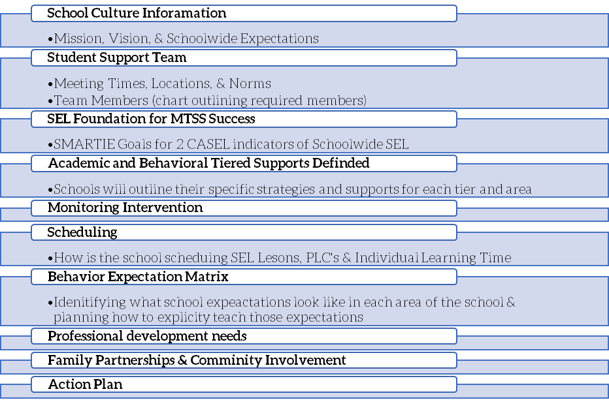
What are the Elements of the School Wide MTSS Plans?

Slide 12
FALL 2021
Spring 2021
Building Relationships
SEL Foundations
SEL Tier I Curriculum
Building Adult Capacity
CASEL SELREA & Findings
Moving PBIS to MTSS
MTSS Proposal and framework
Incorporating SEL into Academics
SEL in school Climate
Building Adult Capacity
MTSS Plan development & rollout
SEL Tier I Curriculum Data reviews
Year 1 was about building a shift in mindset.

Slide 13
FALL 2022
Spring 2022
SEL Tier I curriculum
Identifying Student Support Team
Having SST Meetings
Using EWI system
SEL Tier I Data Reviews
MTSS Plan updates and revisions
Training and Next Steps
SEL Tier I Curriculum Data reviews
What were/are the semester
focus areas?

Slide 14
Thank You!

