Slide 1
LASARD Parent Training Series
January 2023
Julie Riley, M.Ed., BCBA, LBA
LASARD Project Director

Slide 2
Notes:
LASARD is a part of the LSU HSC Human Development Center in New Orleans, which includes other projects that support individuals with development disabilities across the lifespan. These include interdisciplinary programs such as LEND (Leadership Education in Neurodevelopmental and Related Disabilities), Louisiana Deaf-Blind project, PayCheck, an education-employment program, and Early Head Start support. The Human Development Center is Louisiana’s University Center for Excellence in Developmental Disabilities (UCEDD). UCEDDs are part of the AUCD network (Association of University Centers on Disabilities) which include institutions across the US such as Vanderbilt Kennedy Center for Excellence in Developmental Disabilities and the Kennedy Krieger Institute in Baltimore, Mailman Center in Miami, among others. This provides us with a network of experts in the field of developmental disabilities to collaborate with and learn from.

Slide 3
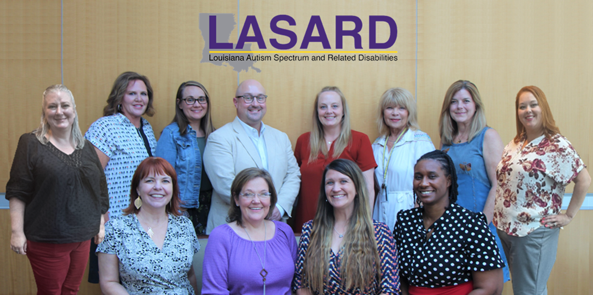
ABOUT US
Notes:
LASARD
LASARD partners with school districts, systems, networks, or individual schools to build their capacity to serve students with disabilities. We do this through team action planning, providing direct training, and coaching in classrooms. We provide educators with evidence-based strategies to improve the academic, social, behavior, and emotional outcomes of students with disabilities.
HDC
The Human Development Center serves as a resource to people with disabilities, families, service providers, educators, and policy-makers. From individuals to systems, HDC builds capacity and inspires change throughout the life cycle to ensure that people with disabilities are able to participate fully in all aspects of community life. HDC has initiatives from birth to adulthood.

Slide 4
District Autism and Related Disabilities Team
The District Autism and Related Disabilities Team was created to assess our district’s strengths and areas of growth and improvement related to serving students with autism and related disabilities and provide resources, training and support to staff and families with the goal of increasing the use of evidence-based practices across all settings that include students with autism and related disabilities.
By using a multi-disciplinary team approach, the team supports teachers to meet students’ needs related to communication, behavioral, sensory, academic, social, and adaptive skills.
Notes:
Explain which activity or tool have you been able to implement in your classroom? How did this affect your students?
Discuss specific areas where you may need more support.
Brainstorm

Slide 5
Autism + Puberty
LASARD FACILITATOR:
Ali Kowitz, M.Ed., ET/P
Full Presentation Date and Time TBD
Notes:
…I am a Program Facilitator with the LA Autism Spectrum and Related Disabilities Project, or LASARD Project.

Slide 6
Parent Training Agenda
How to help children understand puberty
Supports parents can use to teach their children about puberty, including:
Priming
Visual Supports
Social Narratives
Task Analysis
Communication Supports
Q&A
Notes:
As we go forward tonight, just keep in mind that when talking to children/teens with autism it is best to be quite direct in your language, and use your judgement about what you talk about and how based on the questions asked and understanding level of the child/teen. The supports we go over will help you with that.

Slide 7
Preparing Children with Autism for Puberty
Children with autism may need more time and support to understand puberty and the changes that will occur in their bodies and lives.
Your child may feel less confused or worry about the physical changes they experience if they are primed for those changes before they occur.
Autism does not affect when a child starts puberty. Generally speaking, puberty for girls starts around 8-13 years old and puberty for boys begins around 9-14 years old.
Notes:
You know your child best, so you’re the best person to decide how much preparation time your child needs.
There might also be other things that influence your decision. For example, if your child has a behavior or habit – for example, taking their clothes off – that would be best changed before puberty starts, you might start a bit earlier. Your child will need extra help to understand why they can’t take their clothes off any more. Things like social stories, visual schedules and games can all be adapted to teach your child new information about the different topics related to puberty.

Slide 8
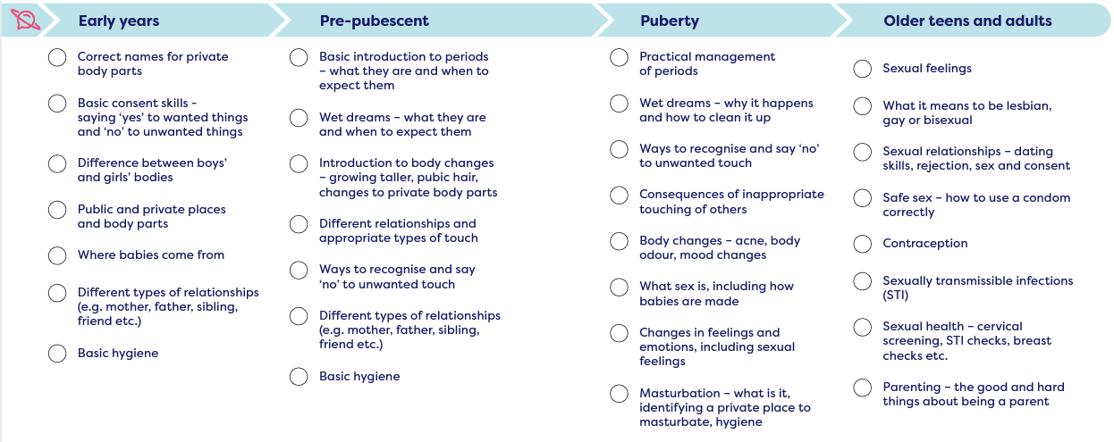
Start with the Basics
https://www.planetpuberty.org.au/wp-content/uploads/2021/06/FAM0001_A5_Brochure_LR_Digital-Version.pdf
Notes:
There is no need to jump straight into the difficult topics. Start with basic information and slowly build on this as your child grows. This list acts as a general guideline for topics to introduce to your child at different stages of their life. If your child is older and has missed some of the things listed under ‘early years’ that is OK. Keep progressing with what they do know and introduce them to the basics of what they have missed. Review this list and think about what your child already knows and understands. What resources and support do they need to be able to understand these changes better?

Slide 9
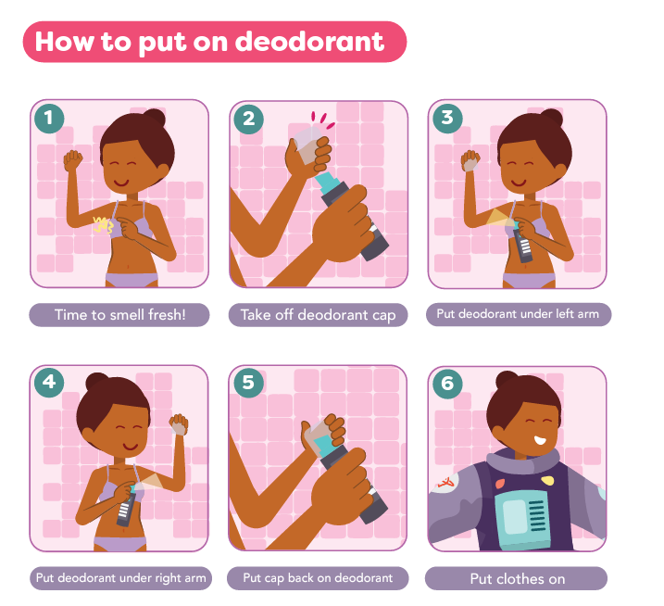
Will my child understand?
Pair your talks about puberty and body changes with:
Priming
Visual Supports
Social Narratives
Task Analysis
Communication Supports
Use clear, direct language:
Phrases such as “voice-cracking/breaking” may lead to unnecessary anxiety because the child may take the phrase literally.
https://www.planetpuberty.org.au/wp-content/uploads/2021/03/How-to-use-deodorant-F.pdf
Notes:
If your child is a teenager but has the cognitive capacity of someone much younger, you may be worried they won’t understand what you’re teaching them about puberty. Regardless of a child’s disability, their body will inevitably change at puberty. These changes can be scary and overwhelming for your child if they are not prepared for them to happen. It is important to start talking to your child about puberty and body changes as early as possible. This will give your child time to understand the changes that will happen to their body and feel prepared for when they start to happen. Many children with disabilities can learn a lot if education proceeds slowly and repetitively in small chunks. It is also important to recognize how your child learns and choose resources and materials that work best for them.

Slide 10
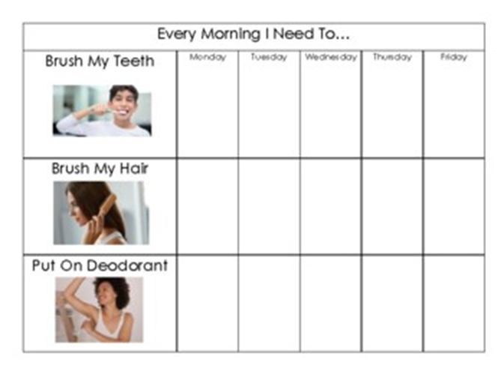
Visual Supports

Slide 11
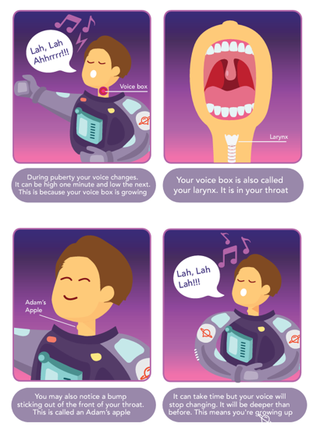
Social Narratives
https://www.planetpuberty.org.au/wp-content/uploads/2021/03/Voice-breaking-F.pdf

Slide 12
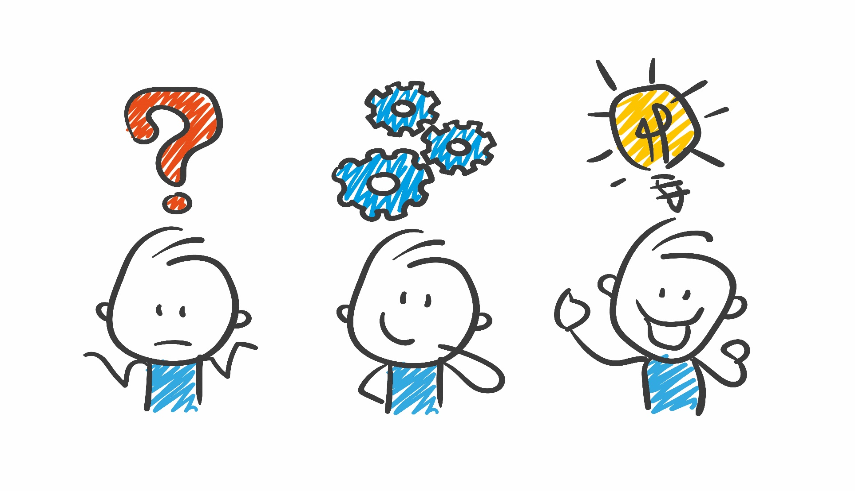
QUESTIONS

Slide 13
CONTACT US!
Julie Riley
jrile1@lsuhsc.edu
www.lasard.org
www.facebook.com/LASARD.Project
www.instagram.com/project_lasard/

